Slide 1
Cluster Analysis

Slide 2
Today . . .
  Hierarchical clustering applied to some MDS and factor analysis data
  K-Means Clustering

Slide 3
Clustering methods can be applied to the same kind of data that are examined using MDS. A proximity matrix can be used as input and the clusters identified using any of the methods.
  Car ratings
  President rankings
  Trump ratings
Previous methods focus on the dimensions that underlie similarity among variables or objects. Cluster analysis focuses on discernable separation of objects into groups.

Slide 4
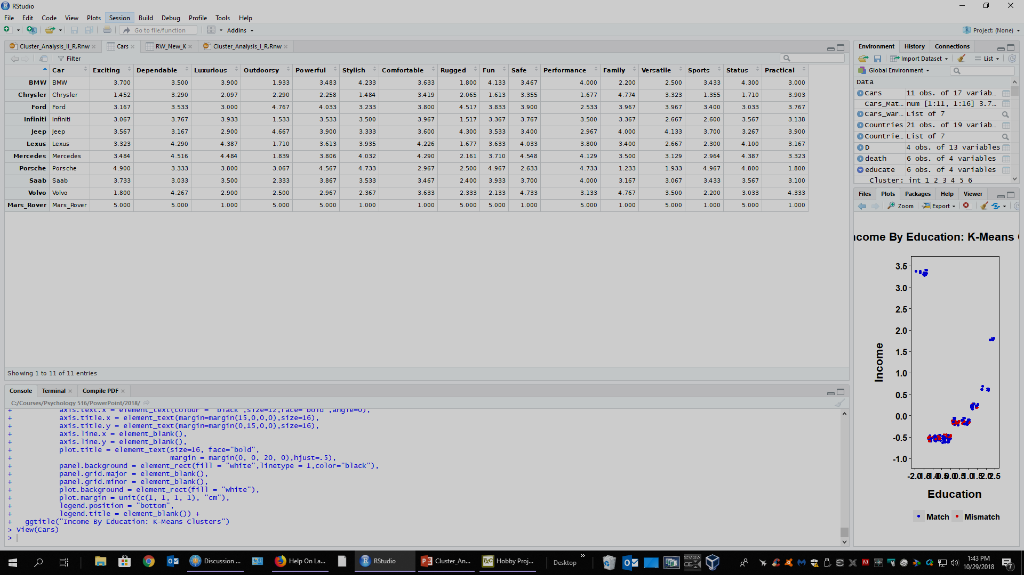

Slide 5
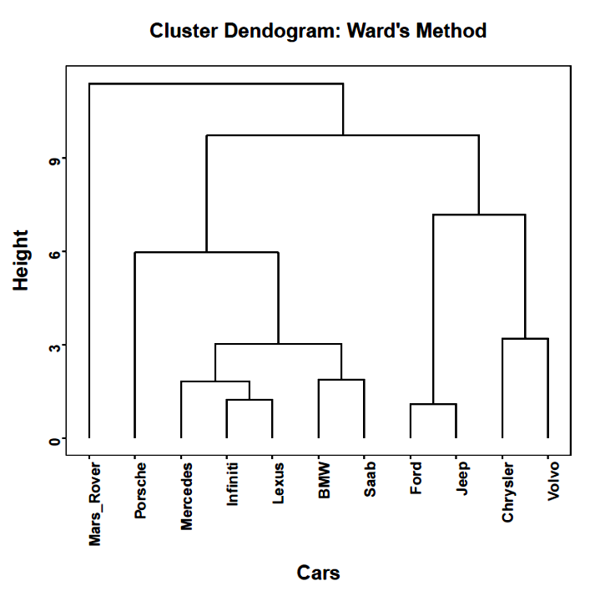

Slide 6
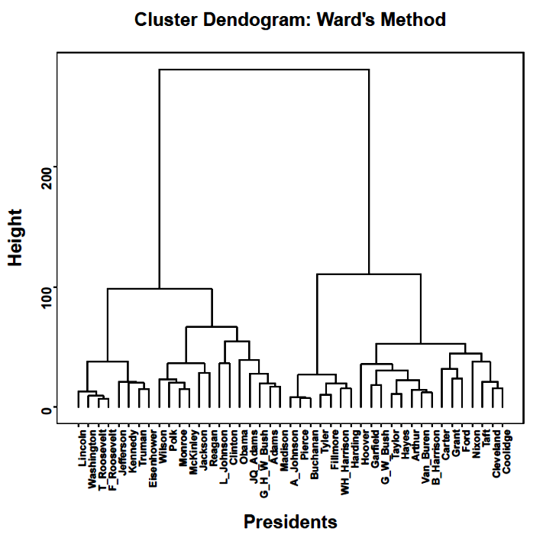

Slide 7
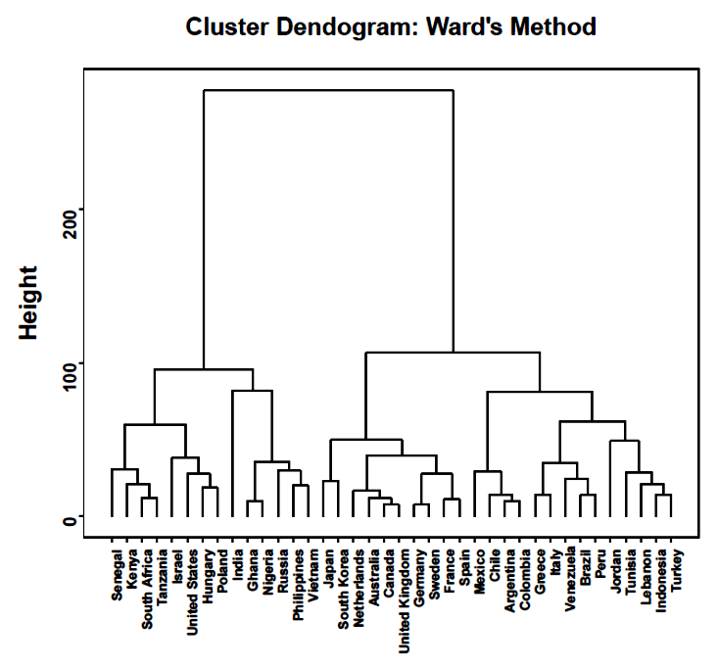

Slide 8
An alternative to the agglomerative, hierarchical approach to clustering more closely resembles the spirit of analysis of variance.
The partitioning procedure known as K-Means clustering attempts to form clusters that have the smallest possible within-cluster variances.

Slide 9
The partitioning approach to finding clusters begins with specification of the number of clusters desired (K) and “seed” values for the initial cluster centroids.
Then, cases are assigned to clusters so that the sum of the squared distances from cases to cluster centroids are minimized.
Cases are reassigned until no further reduction in the sum of squared deviations is found.

Slide 10
The K-Means clustering procedure is similar to Ward’s method, but is not a hierarchical approach. In Ward’s method, when cases are joined in a cluster they cannot later separate and join different clusters. Reassignment is possible in K-Means clustering.
The nature of the final clusters can be heavily dependent on the seed values that are used.
By default, most software chooses an initial set of cases as the seed values, sometimes chosen randomly or to be relatively far apart from each other. Multiple random starts can be specified, with the best solution kept (minimum total within-cluster sum of squares).

Slide 11
To be used in K-Means clustering, variables should be quantitative at the interval or ratio level.
If the variables have different scales, they should be standardized.
Distances are based on simple Euclidean distance.
If the variables are binary or counts, then one of the hierarchical procedures should be used (although counts are sometimes used in K-Means clustering).

Slide 12
The adequacy of the K-Means approach can be tested in the same way as the hierarchical methods—by examining how well it recovers a known structure.
We'll begin by analyzing the iris data. The kmeans( ) function in the basic stats available when R starts up is a good option for most problems. It requires the raw data matrix, with the objects to be clustered on the rows.

Slide 13
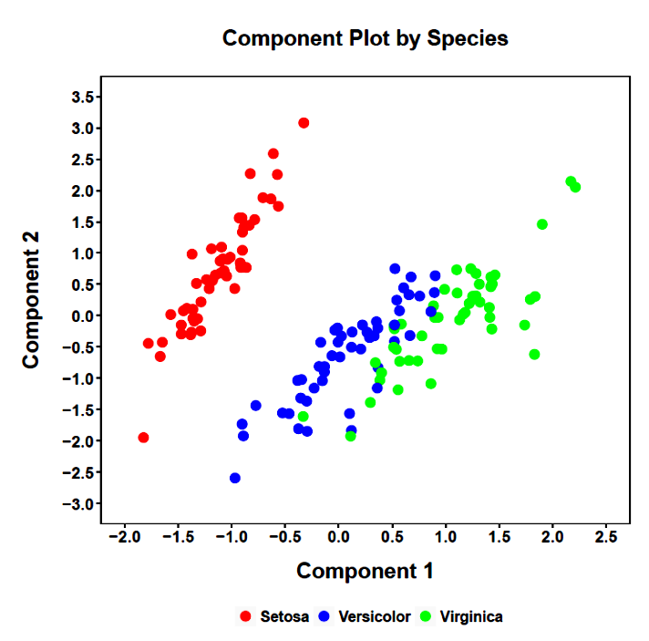




Slide 14
The method attempts to minimize the within-cluster sums of squares. This can be used to help identify the optimal number of clusters. For different numbers of clusters, a point may be found, after which little improvement in the solution occurs.
Similar to a scree plot, the point at which the plot of within-cluster sums of squares reaches a discernible floor can be used as the optimal number of clusters.

Slide 15
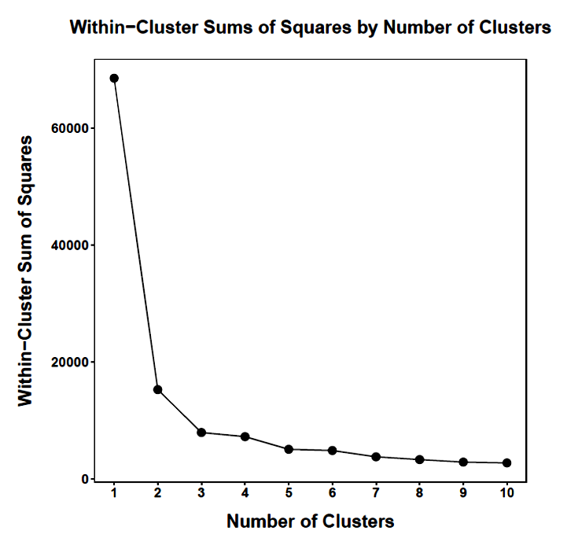
After 3 clusters, there is little additional reduction in the total within-clusters sum of squares.

Slide 16
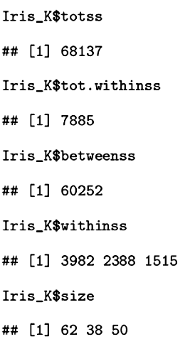
The K-Means procedure finds the K clusters that minimize the total within-cluster sum of squares (tot.withinss).
The other sums of squares provide information about the relative size of between-cluster and within-cluster variability—similar to ANOVA.

Slide 17
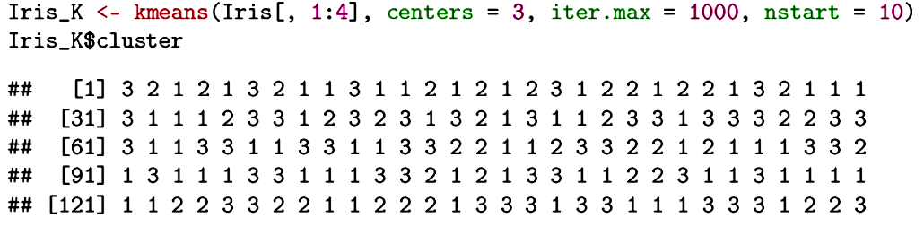
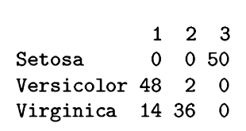
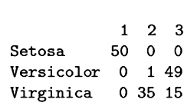
K-Means
The two major methods provide similar classifications.
Ward’s

Slide 18
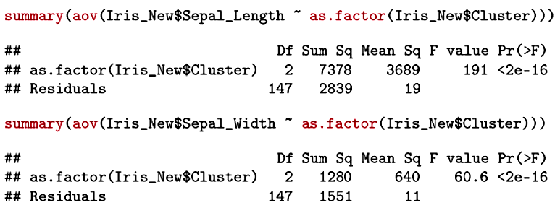

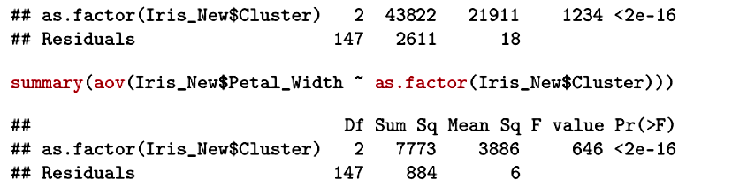

Slide 19
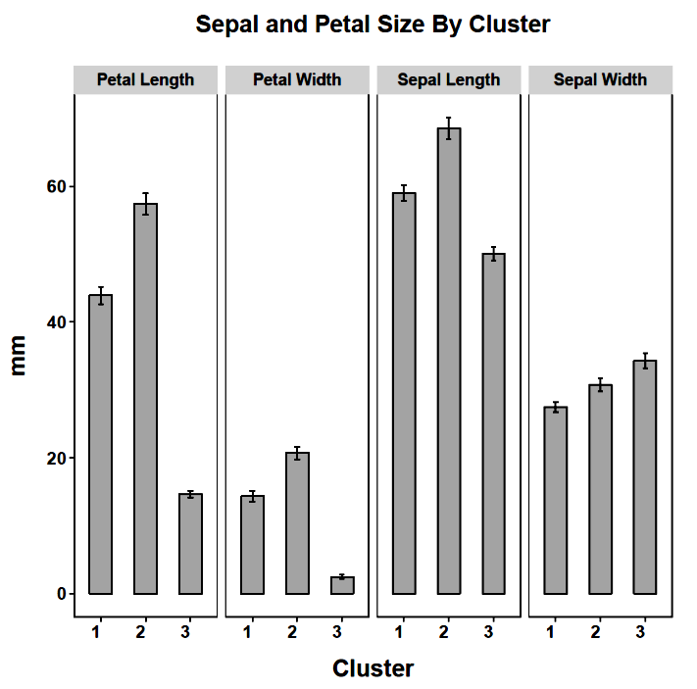

Slide 20
One potential use for cluster analysis is to simplify a sample of data, perhaps when initial analyses suggest a discontinuous nature.
A sample of 150 people were surveyed concerning their opinions about four controversial issues. On a 10-point rating scale, ranging from Completely Disapprove (1) to Completely Approve (10), the respondents rated their opinions of:
  Gun Control
  Prayer in the Schools
  Death Penalty
  Same Sex Marriage

Slide 21
The sample also reported their annual income and their number of years of education.
The role of socioeconomic status in shaping opinions on controversial topics was the goal of the study.
Because of the different scales, all measures are standardized.
An examination of the relationship between education and income revealed an unusual pattern.

Slide 22
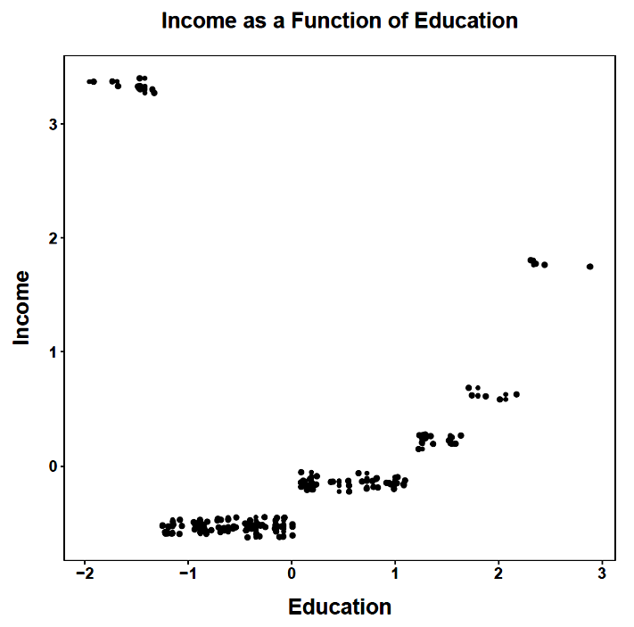

Slide 23
We can analyze these data using either hierarchical or K-Means clustering. Using Ward’s hierarchical method, we can plot the height at which cluster joining occurs and identify the point at which clear breaks occur.

Slide 24
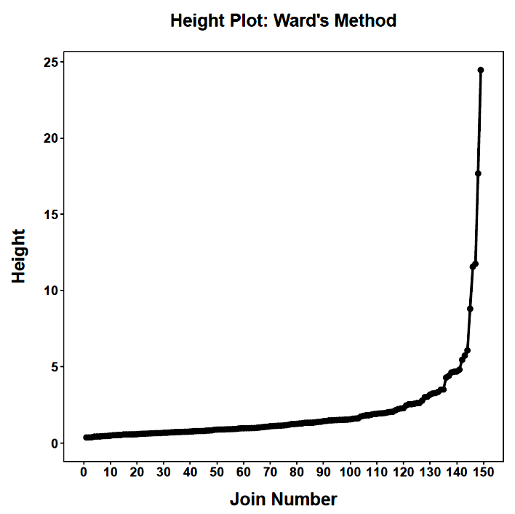
The first join noticeably above the rest suggests 6 clusters (one more than number of joins above the rest).

Slide 25
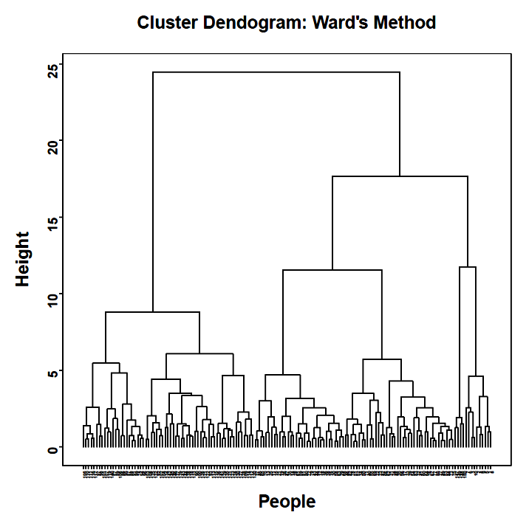

Slide 26

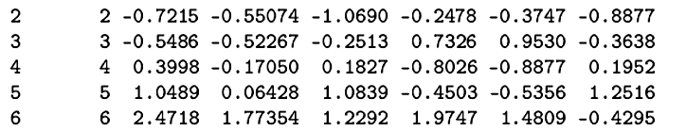
Cluster membership is strongly driven by income and education.
What problem will the single linkage method encounter with these data?

Slide 27
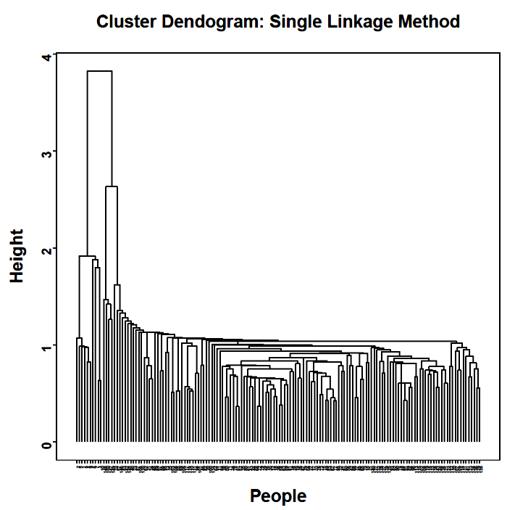

Slide 28
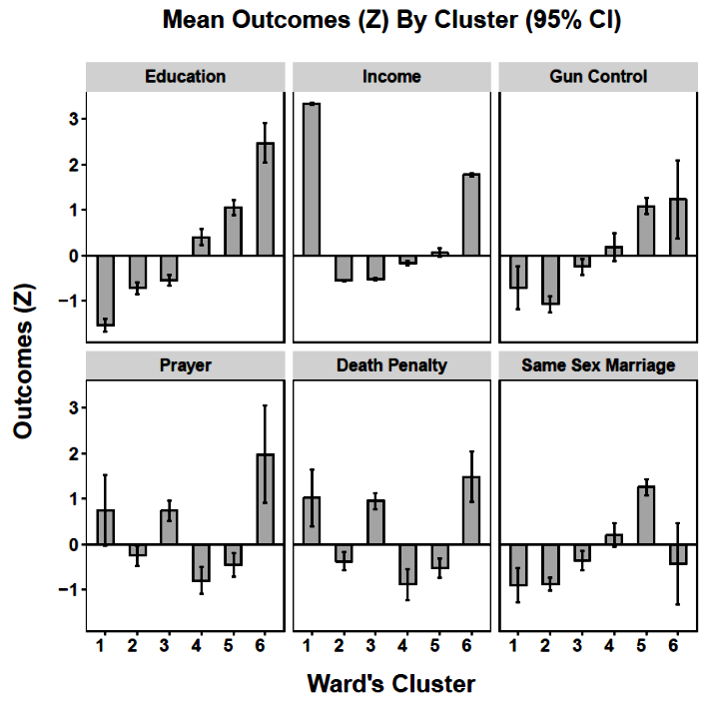

Slide 29
To determine the appropriate number of clusters in the K-Means approach, we can plot the within-cluster sums of squares for different numbers of clusters. Here, too, the plot resembles a scree plot and can be used to identify a number of clusters that produces the greatest reduction in within-cluster error.

Slide 30
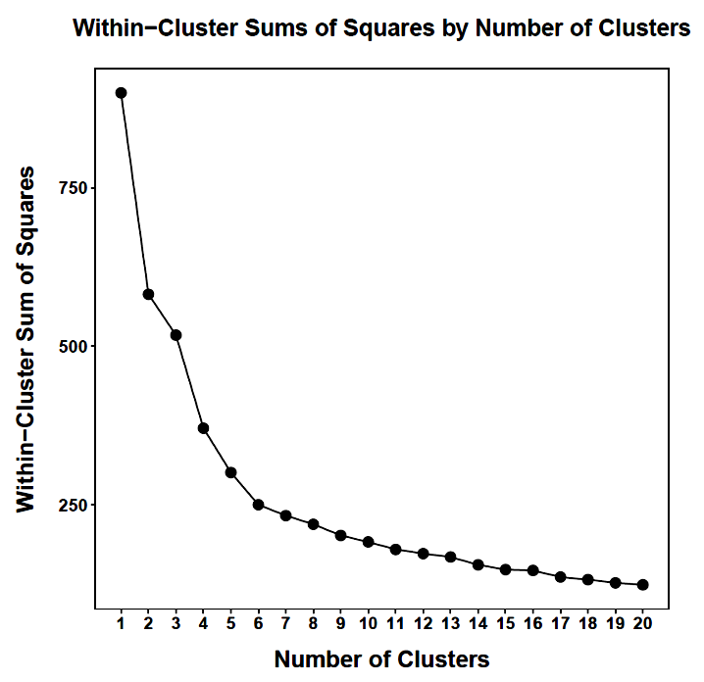
After 6 clusters, there is little additional reduction in the total within-clusters sum of squares.

Slide 31
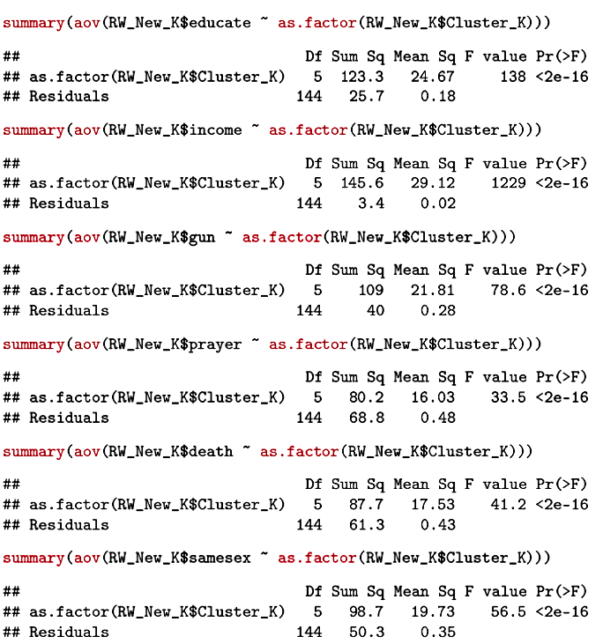
Unsurprisingly the clusters are different on education and income. They are different on the other measures too.

Slide 32
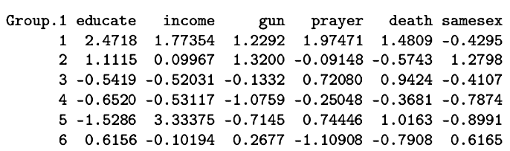
The highlighted clusters have similar education and income, but different attitudes about the issues.
Cluster 5 is the undereducated über-rich group; they are fairly right-wing in their attitudes.

Slide 33
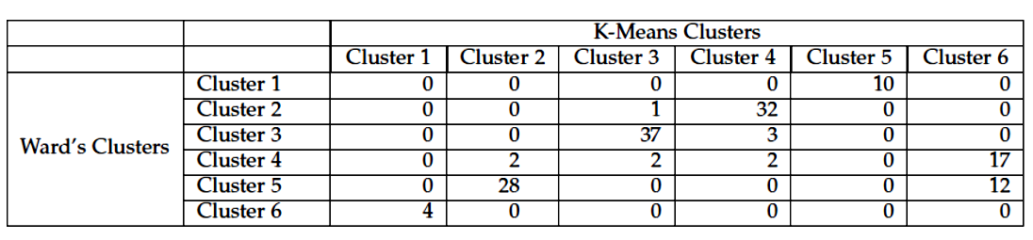
The hierarchical and K-Means methods need not arrive at the same cluster identifications, although if there is a strong cluster structure to the data, they each ought to arrive at this underlying truth.

Slide 34
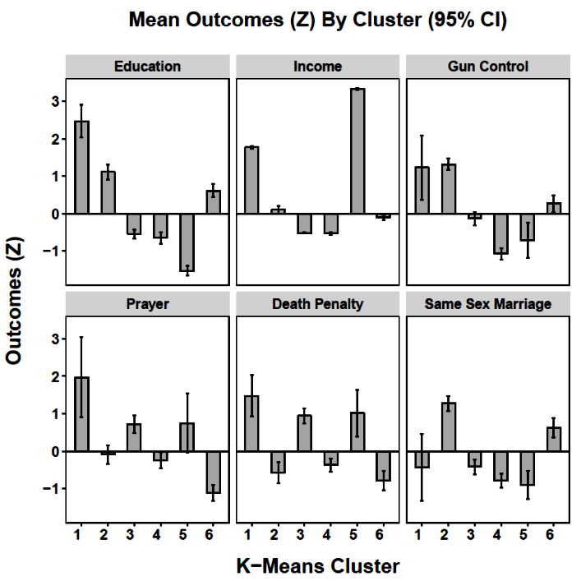

Slide 35
Next time . . .
Additional issues in cluster analysis

